Slide 1
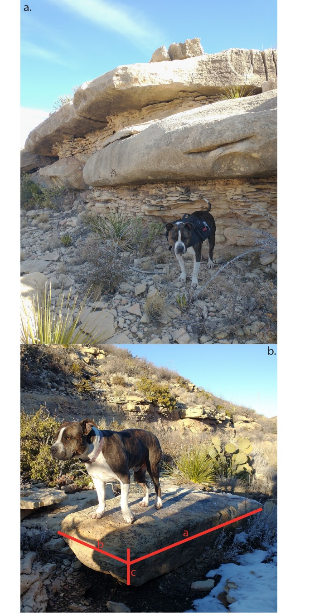
INTRO Figure : Field photos showing a) exposed beds of varying thicknesses and b) a boulder in the channel with dimensions reflective of proximal exposed bedrock.

Slide 2
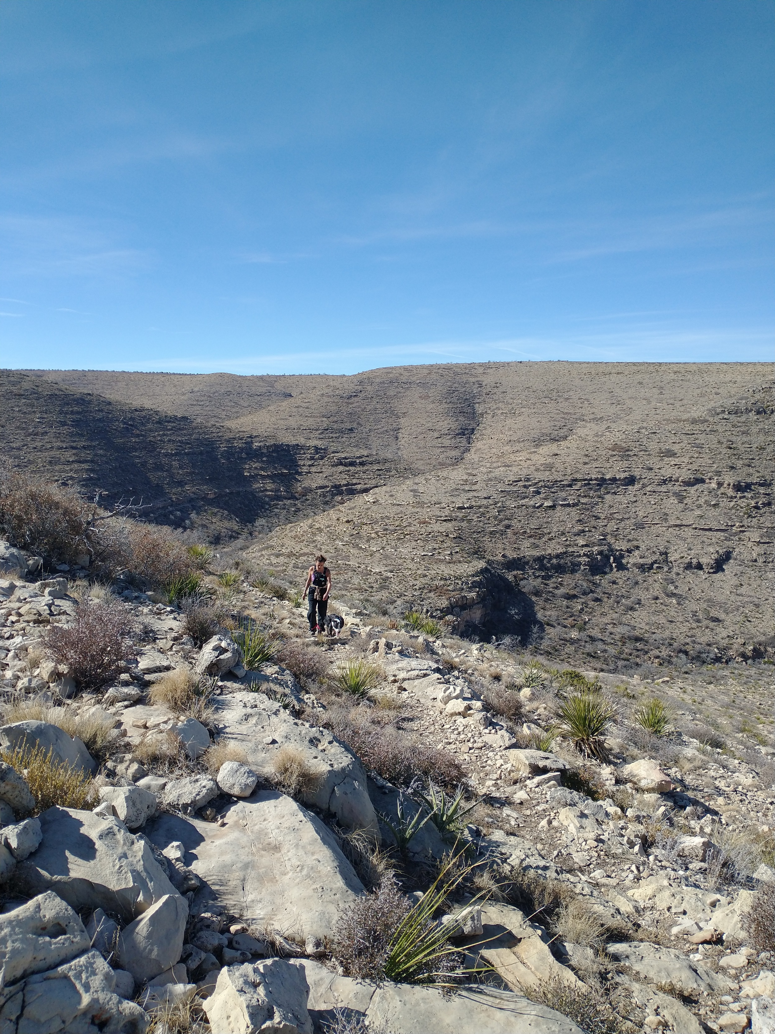
INTRO Figure : Field photo highlighting the steep downstream and shallow upstream hillslopes.

Slide 3
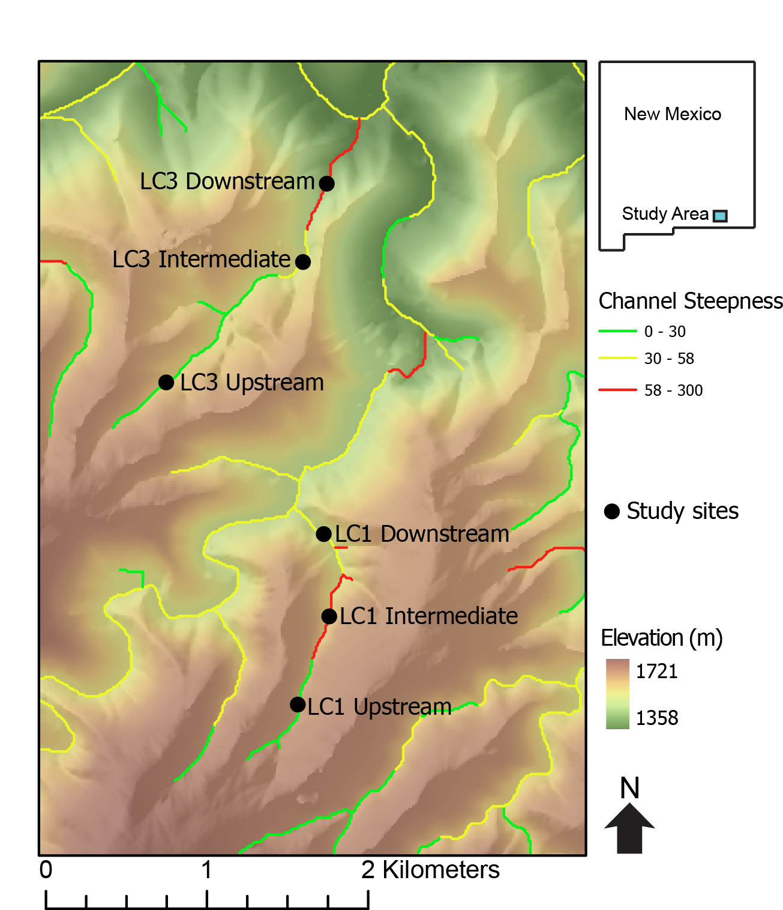
Figure : Topographic map superimposed on a hillshade of Last Chance canyon with ephemeral stream channels. Main stem of channel colored black with arrow indicating the direction of stream flow. The seven hillslope transects in the two different watersheds shown here.
Notes: split into two figures
One with the two watersheds highlighted
No ksn
Second with the transects and Ksns
Other LC3 Upstream

Slide 4
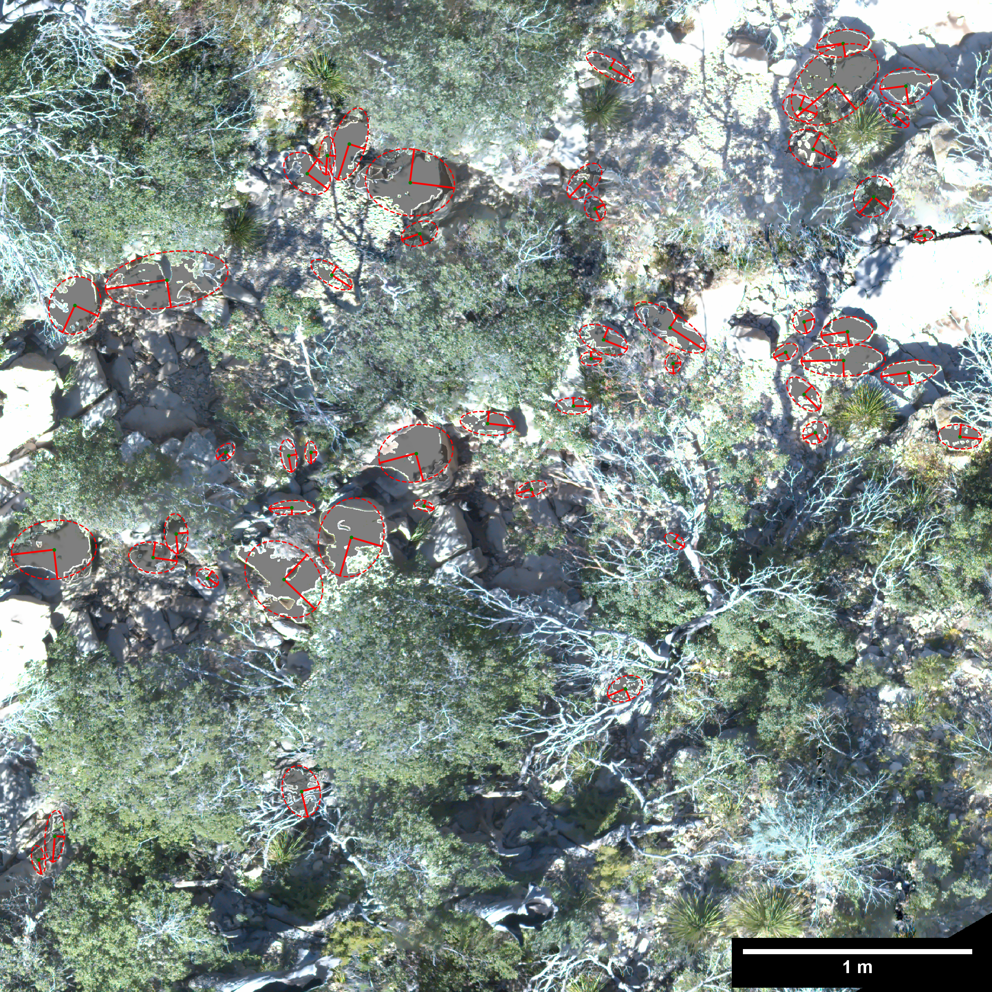
Figure : Orthomosiac illustrating the photosieving methodology used to measure sediment sizes in stream channels below the seven hillslope transects. Each measured sediment grain has an ellipse with the a (longer) and b axis (shorter) shown.

Slide 5
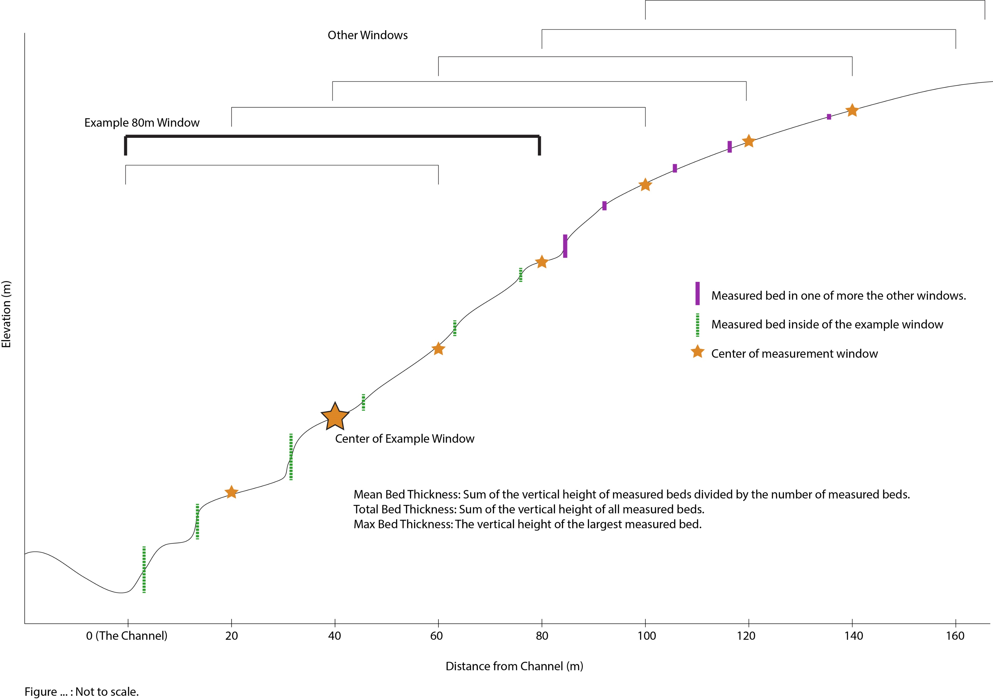
Figure : Schematic (not to scale) demonstrating the 80m window over which both slope and curvature were measured. Note that the 80m window shrinks at the edges of the transect so that data is taken from only the hillslope in question.

Slide 6
Figure : Figure showing the control bed thickness has on slope. Data for both slope and bed thickness are taken over an 80m window. Total thickness is all of the bed heights in he 80m window added together. Mean thickness is the average bed thickness in the window. Max thickness is the vertical distance of the largest bed in the window.

Slide 7
Figure : Bed thicknesses over the entire hillslope transect vs. slope of the entire transect.

Slide 8
Figure : Figure showing the control that sediment size has on channel steepness (ksn). The sediment diameter data was acquired via the photo sieving method described earlier.

Slide 9
Figure : Bed thicknesses of the entire transect vs. a) average diameter of the b axis of alluvium in the channel below one of the seven hill slope transects and b) channel steepness (ksn) of the channel below each of the seven hill slope transects.

Slide 10
Figure : Bed thicknesses over the entire hillslope transect vs. channel steepness (ksn) of the channel below each of the seven hill slope transects.

Slide 11
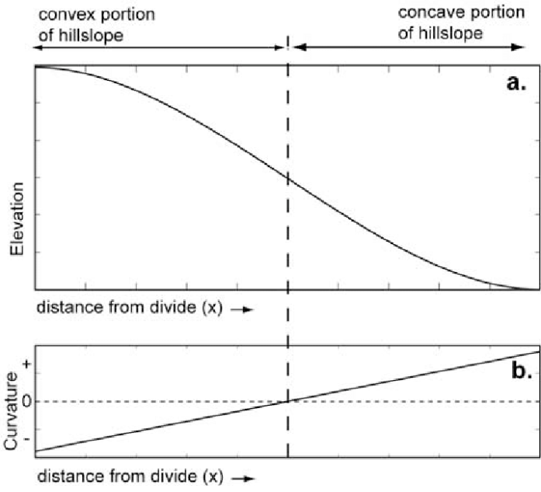
Figure : THIS FIGURE IS UNDER CONSTRUCTION I WANT TO SHOW HOW DIFFUSIVITY CHANGES WITH BED THICKNESS.
a) An idealized hillslope that shows curvature going from positive to negative as distance from channel increases. b) Shallow hillslope transect in LC3 that resembles the diffusive hillslope in a). Max bed thicknesses over each of the seven transects vs c) the slope of the distance vs curvature function and d) the r squared of the distance vs curvature function.

